Slide 2
Digital White Board
Submitted to:
Department of Computer Science and Engineering

Slide 3
Team Members
1.Omansh Kalra
2.Rahul Choudhary

Slide 4
Project Presentation Outline
Abstract
Introduction
Problem Statement
Survey of Existing Systems
Project Objectives
Requirement Analysis
Solution Proposed
Models and Diagrams
The Implementation
Testing
The Outcome Discussion
Conclusions and Limitations

Slide 5
Abstract
This Project is developed keeping in mind the effect of the pandemic situation on our educational system. As Everything is going online so we decide to make this project which can be used by teachers to teach there students online easily.

Slide 6
Introduction
Digital White Board is a desktop application build on Qt 5.14.2 using C++. This application will provide various features like drawing shapes (such as a line , rectangle , circle) , a freehand tool for writing , grouping/ungrouping of shapes drawn , inserting images, clearing the canvas ,save/open files that are drawn on the canvas. It can used in a variety of settings, including classrooms at all levels of education, in corporate board rooms and work groups, in training rooms for professional sports coaching, in broadcasting studios, and others.

Slide 7
The Problem Statement
As the world is moving forward towards digitalization so keeping the education as 1st priority for students as well as the faculties. So, keeping all the scenarios in mind the currently available digital education tools are somehow difficult to use for normal people. Since the pandemic happened everything is going online, including online classes for students and there are very limited number of resources available for the teachers to teach students digitally without a physical board so for this we are creating a digital education tool which is much easier as compared to other existing tools so that teachers can use this tool for teaching students digitally.

Slide 8
Survey of Existing Systems
There are several tools available such as paint , google meet and zoom for digital education which contains pen with different colors and sizes can insert images and shapes but they also comes with some disadvantages such as these tools does not contains subject specific teaching assistance.

Slide 9
Objectives
There will be a virtual white board available on which user can write and draw with the help of free hand tool.
There will be a feature to draw shapes such as circle , rectangle and line.
There will be a feature by which user can select the drawing components.
There will be a feature of drag and drop by which user can move components.
There will be a feature of resizing components.
There will be a feature of inserting images on virtual board and also have feature of clearing the virtual white board canvas.

Slide 10
Requirement Analysis
Software Requirements:
Windows 7 or higher
Visual Studio Code
Qt 5.14.2
Hardware Components:
Processor –Core i3
Hard Disk – 160 GB
Memory – 256 MB Of RAM
Monitor

Slide 11
Solution Proposed
For the development of this project we are using a tool called QT through which GUI applications can be made using C++ programming language. With the help of QT the front end of our application will be made and the backend will be developed using C++.

Slide 12
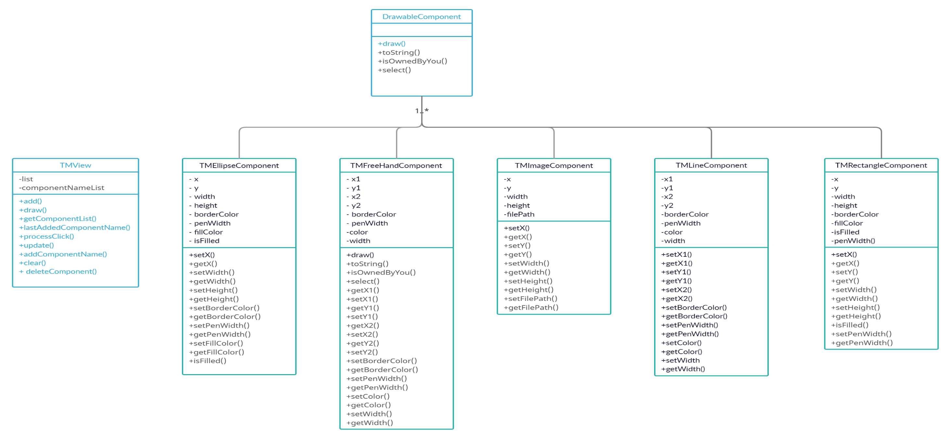
Models/Diagrams

Slide 13
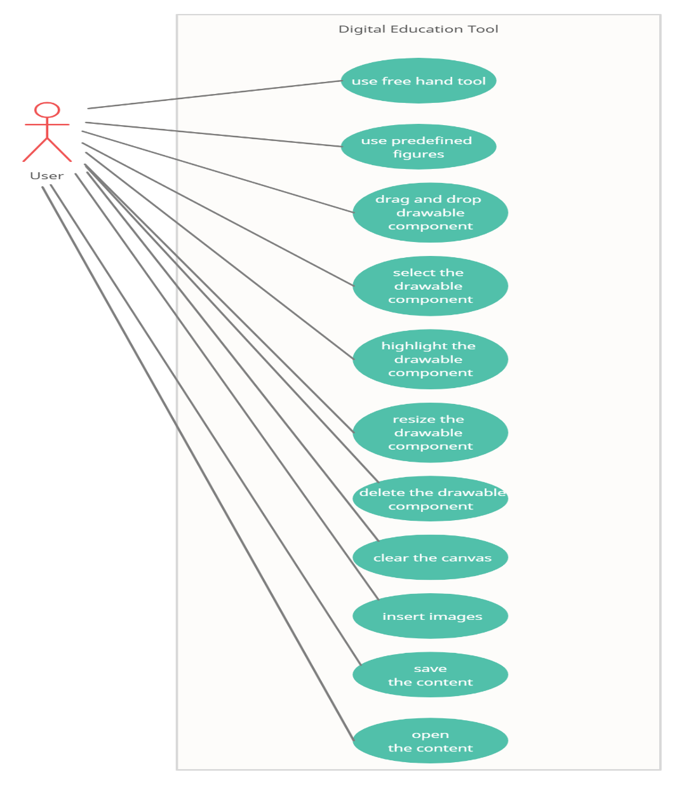
Models/Diagrams

Slide 14
Conclusion and Limitation
Now coming to the end of the presentation, the digital education tool developed is much more handy , easier to use for almost everyone , and for nowadays it has become a necessity for the society as it requires less time and less hard work to become knowledgeable. But every good thing comes with a limitation and in this application it is screen recording, but we will overcome this in a very short period of time.

Slide 15
Q&A

Slide 16
THANKS

